Slide 1
Conflict and cohesion in groups
Group 5
Nguyen Tran Phong
Vo Van Thanh Phuc
Nguyen Tuan Anh
Nguyen Le Anh

Slide 2
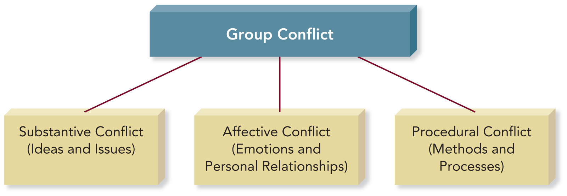
1. CONFLICT IN GROUPS
Conflict is frequently associated with fighting, anger, and hostility.
Definition of conflict: The disagreement and disharmony that occur in groups when members express differences regarding group goals; member ideas, behavior, and roles; or group procedures and norms.

Slide 3

1.1 SUBSTANTIVE CONFLICT
Substantive conflict occurs when members disagree about issues, ideas, decisions, actions, or goals.

Slide 4
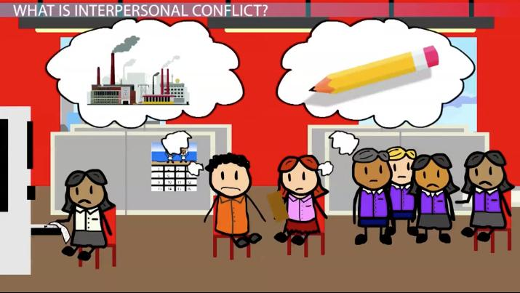
1.2 AFFECTIVE CONFLICT
Affective conflict is the result of interpersonal disagreements, differences in personalities and communications styles, and members’ conflicting core values and beliefs.
“This often leads to avoidance. The parties in the conflict begin to seek ways to do their work without having to interact” (Gastil J., The Group in Society, p.177).

Slide 5
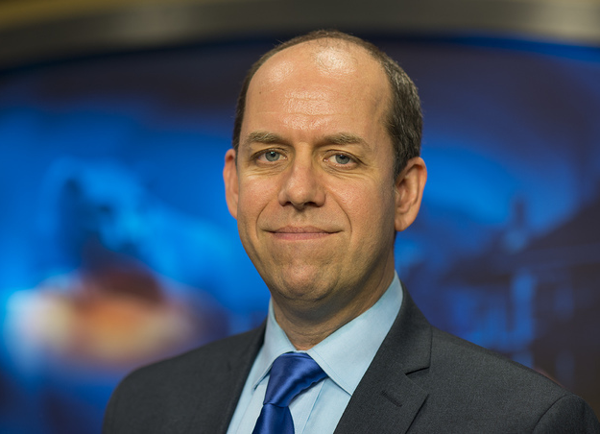
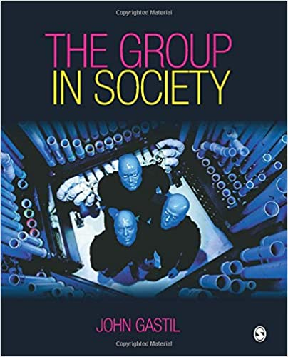
1.2 AFFECTIVE CONFLICT
“This often leads to avoidance. The parties in the conflict begin to seek ways to do their work without having to interact”
(Gastil J., The Group in Society, p.177)

Slide 6
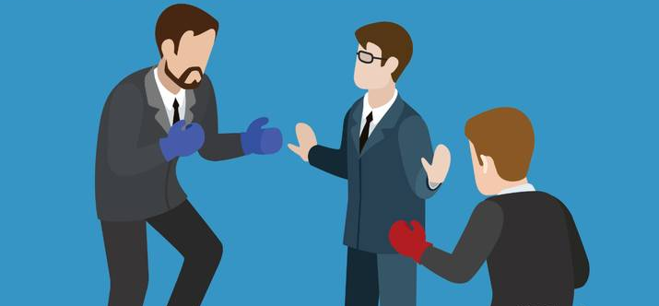
1.3 Procedural conflict
Procedural conflict is disagreement among group members about the method or process the group uses in its attempt to accomplish a goal.

Slide 7
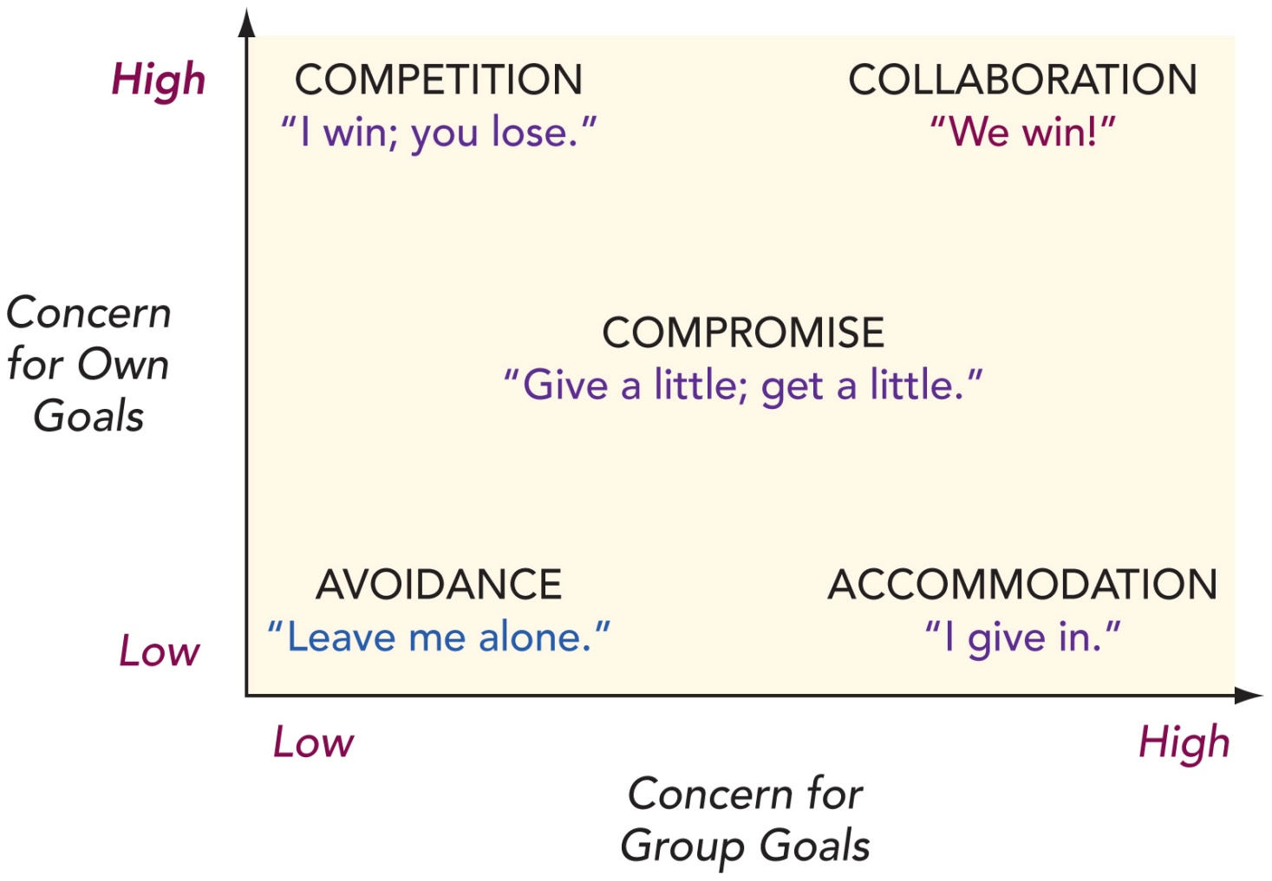
2. CONFLICT STYLES

Slide 8

2.1 avoidance conflict style
Members use an avoidance conflict style when they are unable or unwilling to accomplish their own goals or contribute to achieving the group’s goal.
Appropriate circumtances:
The issue is not that important to you.
You need time to collect your thoughts or control your emotions.
Other group members are addressing the problem effectively.
The consequences of confrontation are too risky.

Slide 9
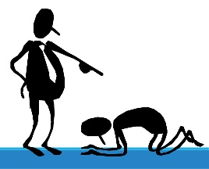
2.2 Accommodation conflict style
Group members using the accommodation conflict style give in to other members at the expense of their own goals.
Appropriate circumstances:
The issue is very important to others but is not very important to you.
It is more important to preserve group harmony than to resolve the issue.
You realize you are wrong or you have changed your mind.
You are unlikely to succeed in persuading the group to adopt your position.

Slide 10

2.3 Competition conflict style
The competition conflict style occurs when group members are more concerned with their own goals than with meeting the needs of the group.
Appropriate circumstances:
You have strong beliefs about an important issue.
The group must act immediately on an urgent issue or in an emergency.
The consequences of the group’s decision may be very serious or harmful.
You believe that the group may be acting unethically or illegally.

Slide 11
2.4 compromise conflict style
The compromise conflict style is a middle ground approach to conflict in which group members give in on some goals in order to achieve other goals they want more strongly.
Appropriate circumstances:
Other methods of resolving the conflict are not working.
The members have reached an impasse and are no longer progressing toward the reasonable solution.
The group does not have enough time to explore more creative solutions.

Slide 12

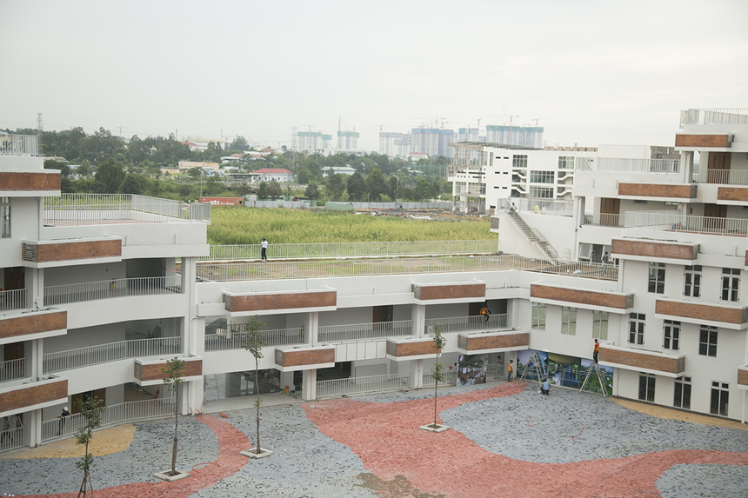
2.4 compromise conflict style

Slide 13
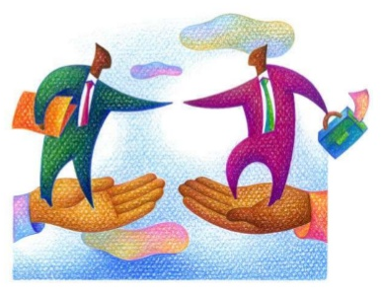
2.5 collaboration conflict style
The collaboration conflict style searches for new solutions that will achieve both the individual goals of group members and the goals of the group.
Appropriate circumstances:
They want a solution that will satisfy all group members.
They need new and creative ideas.
They need a commitment to the final decision from every group member.
They have enough time to commit to creative problem solving.

Slide 14
3. Constructive and destructive conflict
All groups, no matter how conscientious or well mannered, experience conflict.
Constructive Conflict | Destructive Conflict
Focus on issues | Focus on personalities; makes personal attacks
Repsect for others | Disrespectful tone of voice or body language; insults
Supportiveness | Defensiveness
Flexibility | Inflexibility
Cooperation; seeking win-win solutions | Competition; seeking “I win” solutions
Commitment to conflict management | Conflict avoidance

Slide 15
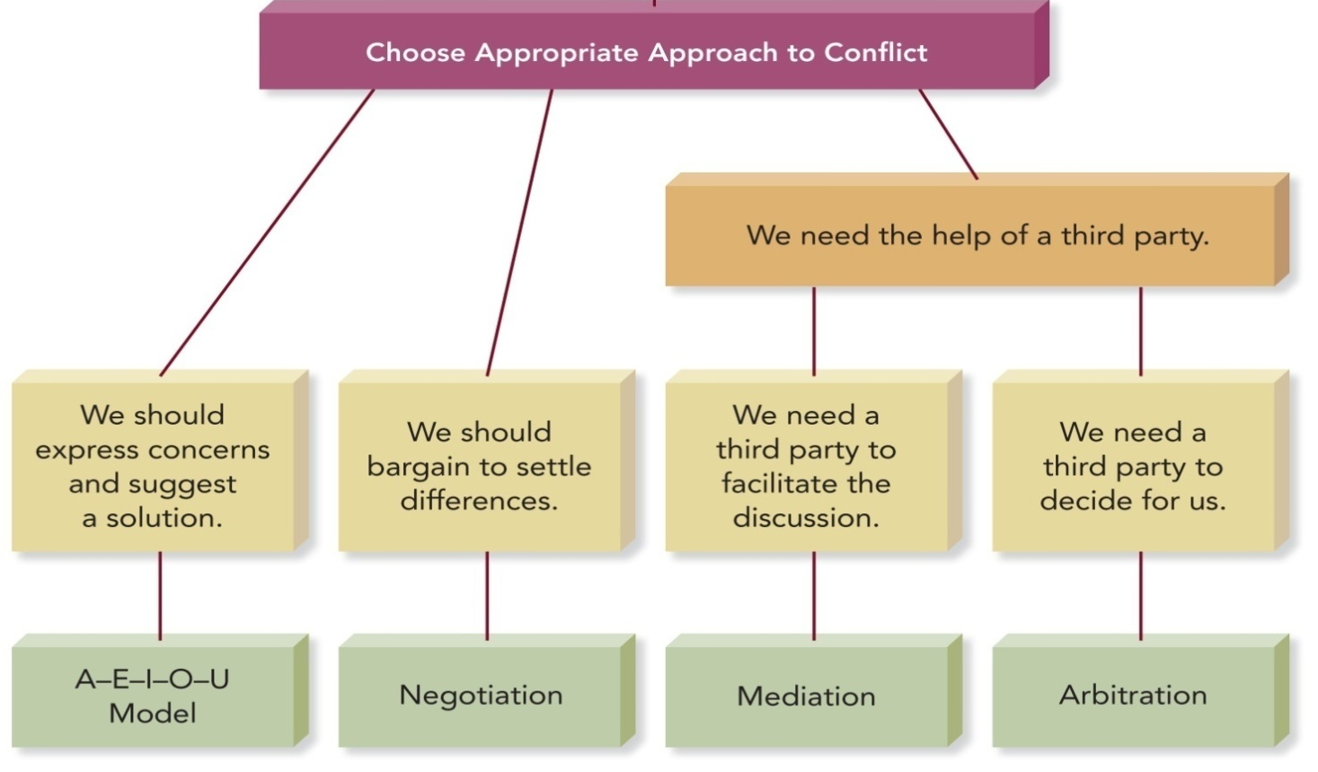
4. Conflict management strategies

Slide 16
4.1 the a-e-i-o-u model
Jerry Wisinski’s A-E-I-O-U Model focuses on collaboration and what he calls positive intentionality, the assumption that other people are not trying to cause conflict.
 | Description | Example
A | Assume that the other person means well. | “I know that all of us want this project to succeed.”
E | Express your feelings. | “Like most of you, I’m frustrated because it seems we’re not putting in the work that’s needed.”
I | Identify what you would like to have happen. | “I’d like to be assured that all of you are as concerned about the success of this project as I am, and that you’ve been thinking about how we can make sure the work gets done on time.”
O | Outcomes you expect are made clear. | “I sincerely believe that if we don’t work late for the next couple of days, we won’t finish this project on time.”
U | Understanding on a mutual basis is achieved. | “Could we try staying late tonight and tomorrow and then evaluate our progress? What do you think?”

Slide 17

4.2 negotiation in groups
Negotiation is a process of bargaining in order to settle differences or solve a problem.

Slide 18
4.2 negotiation in groups
Elements | Principles
People | Separates people from the problem.
Interests | Focuses on group interests, not positions.
Options | Generates a variety of possible solutions.
Criteria | Insists on objective criteria.
Fisher R. et al. Getting to Yes: Negotiation Agreement without Giving in, 1991, p.15

Slide 19
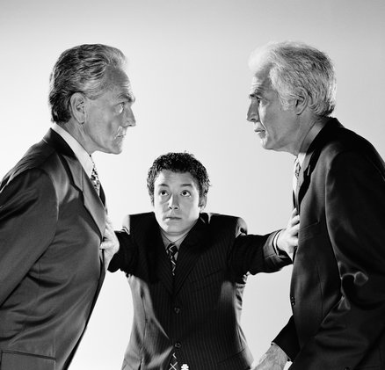
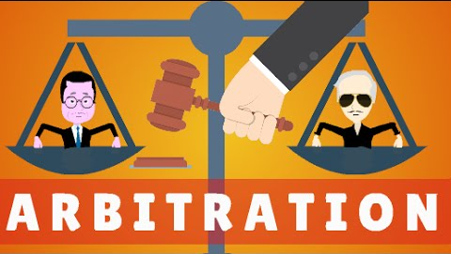
4.3 third-party intervention
MEDIATION
Employs the services of an impartial third party who guides, coaches, and encourages disputants through negotiation to successful resolution and agreement.
ARBITRATION
After considering all sides, the agreed-upon arbitrator decides how to resolve the conflict.

Slide 20
5 conflict and member diversity
GENDER
Female is more likely to avoid conflict or to leave a group when there is continuous conflict.
Wilmot W., Hocker J., Interpersonal Conflict, 6th ed, 2001, p.31
Female privately discuss conflicts.
Tannen D., The Argument Culture: Moving from Debate to Dialogue, 1998, p.196
Conflict style is not driven by biological sex, regardless of how many studies try to find the effect; it’s simply not there.
Nicotera A., Dorsey L., Individual and Interactive Processes Organizational Conflict, 2006, p.312
CULTURAL
Members from collectivist cultures that value cooperation are less likely to express disagreement than are member from cultures that place a higher value on individualism.
Examples:
Japanese, German, Mexican, and Brazilian cultures tend to value group cooperation.
U.S., British, Swedish, and French cultues are generally more comfortable expressing differences.

Slide 21
6 group cohesion
Working in groups requires group cohesion, the mutual attraction that holds the members of a group together.
A cohesive group has:
High level of interaction.
A friendly and supportive communication climate.
A desire to conform to group expectations.
The use of creative and productive approaches to achieving goals.
Satisfied members.

Slide 22

6.1 Enhancing group cohesion
Establish a group identity and traditions.
Emphasize teamwork.
Recognize and reward contributions.
Respect group members.

Slide 23
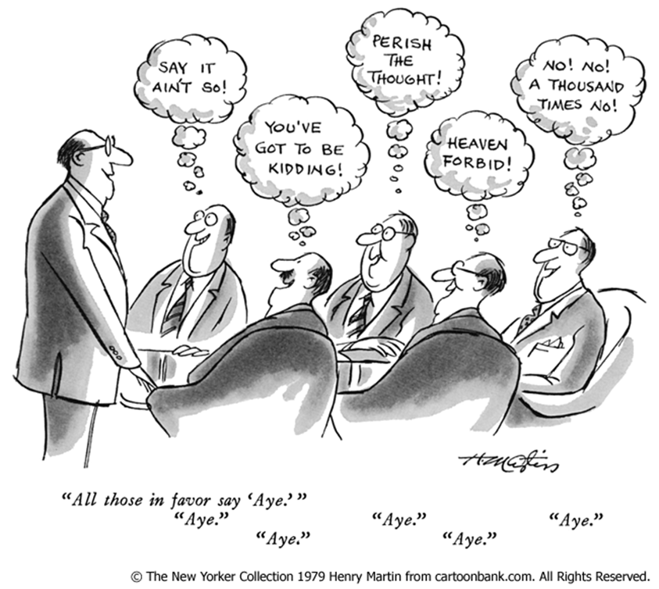
6.2 groupthink
Groupthink refers to a deterioration of mental efficiency, reality testing and moral judgment that results from in-group pressure.
The group is highly cohesive: may overestimate their competence and perceptions of rightness.
There are structural flaws: Such flaws “inhibit the flow of information and promote carelessness in the application of decision-making procedures”.
The situation is volatile: When a group must make a high-stakes decision, members may rush to make a flawed decision and shut out other reasonable options.

Slide 24
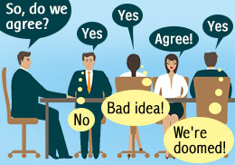
6.2 groupthink
SYMPTOMS OF GROUPTHINK
Invulnerability: Overly confident; takes big risks.
Rationalization: Makes excuses, ignores warnings.
Morality: Ignores ethical and moral issues.
Stereotyping Outsiders: Considers others too weak or stupid to cause trouble.
Self-Censorship: Unwilling to disagree; doubts their own concerns.
Pressure on Dissenters: Pressures members to agree.
Illusion of Unanimity: Believes everyone agrees.
Mindguarding: Shields members from adverse information or opposition.

Slide 25
6.2 groupthink
PREVENTING GROUPTHINK
Ask all members to serve as critical evaluators.
Assign several members to work on the same problem independently.
Discuss the group’s progress with someone outside the group.
Invite an expert to join a meeting and encourage constructive criticism.
Before finalizing a decision, give members a second chance to express doubts.

